Slide 1
Q1_Does_OVX_affect_MWM_performance.R
Code is in the github repository.

Slide 2
TODO
Look at the within-day trial learning – do they learn within-day at the same rate?
The % time in goal quadrant seems like a decent predictor.
Brainstorm: 2012 paper – they looked at the number of trials where the same strategy was used over and over – block length.

Slide 3
Questions
Why are so many latences to goal empty? No data?
For CIPL and other scores, do we average all trials or take the first or last? Does this depend on acquisition and reversal?
How were the probe trials handled – do we just take the percent time in target quadrant?
Goal crossings – there is a number in that column – indicating how many times the mouse crossed – but need to verify this.

Slide 4
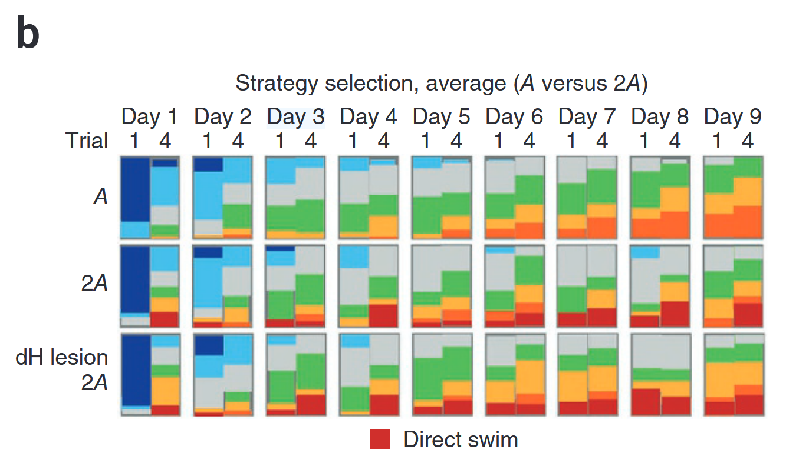
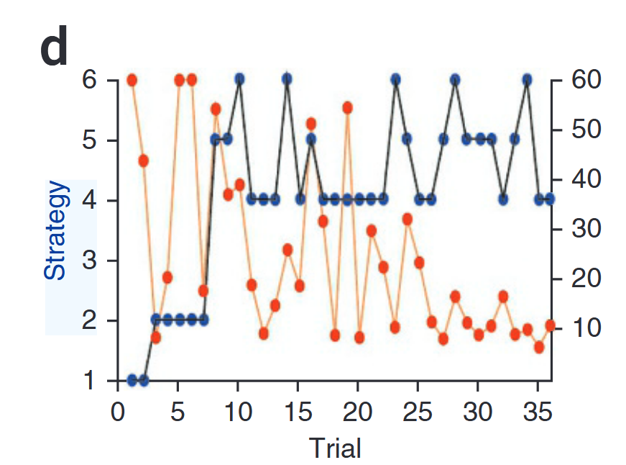
Some plots to consider using….
CIPL

Slide 5
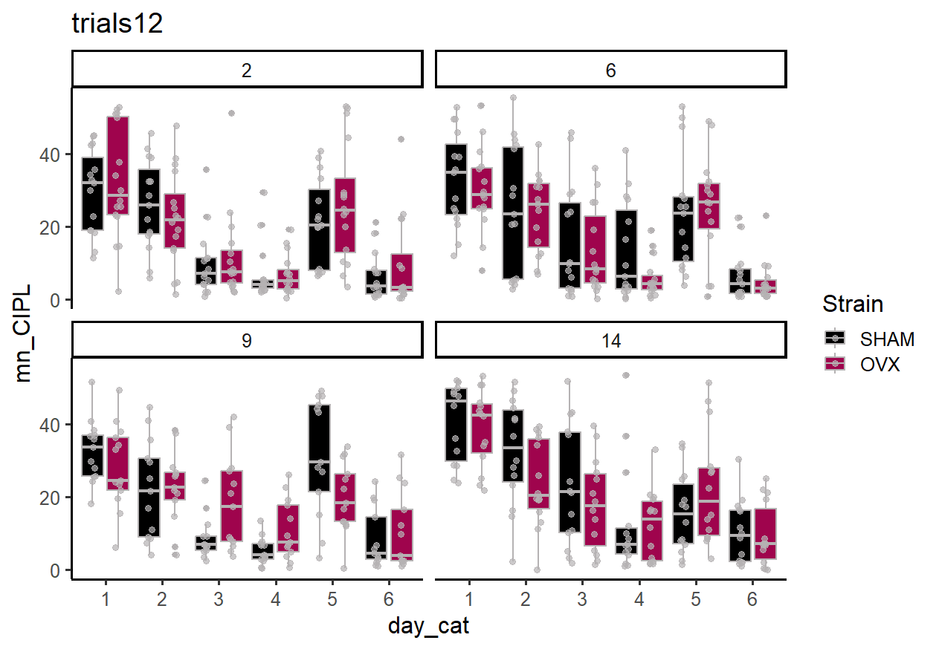

Slide 6
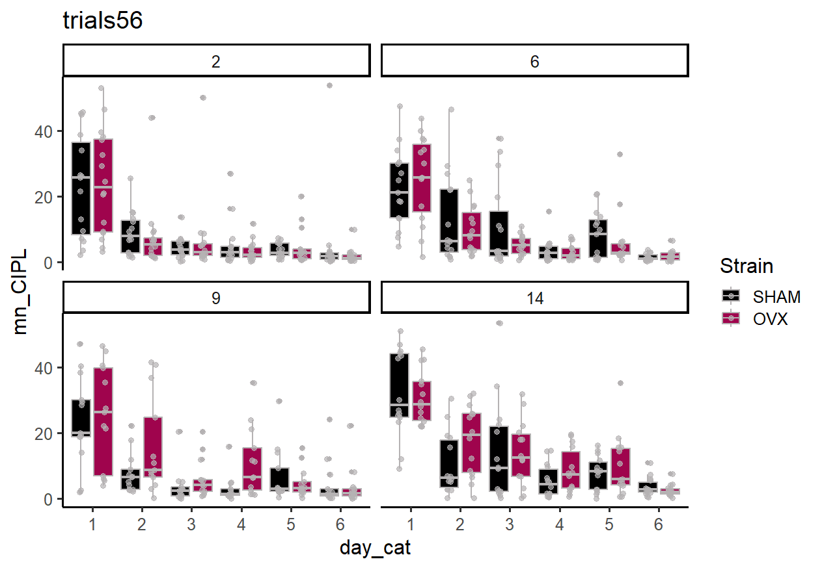

Slide 7
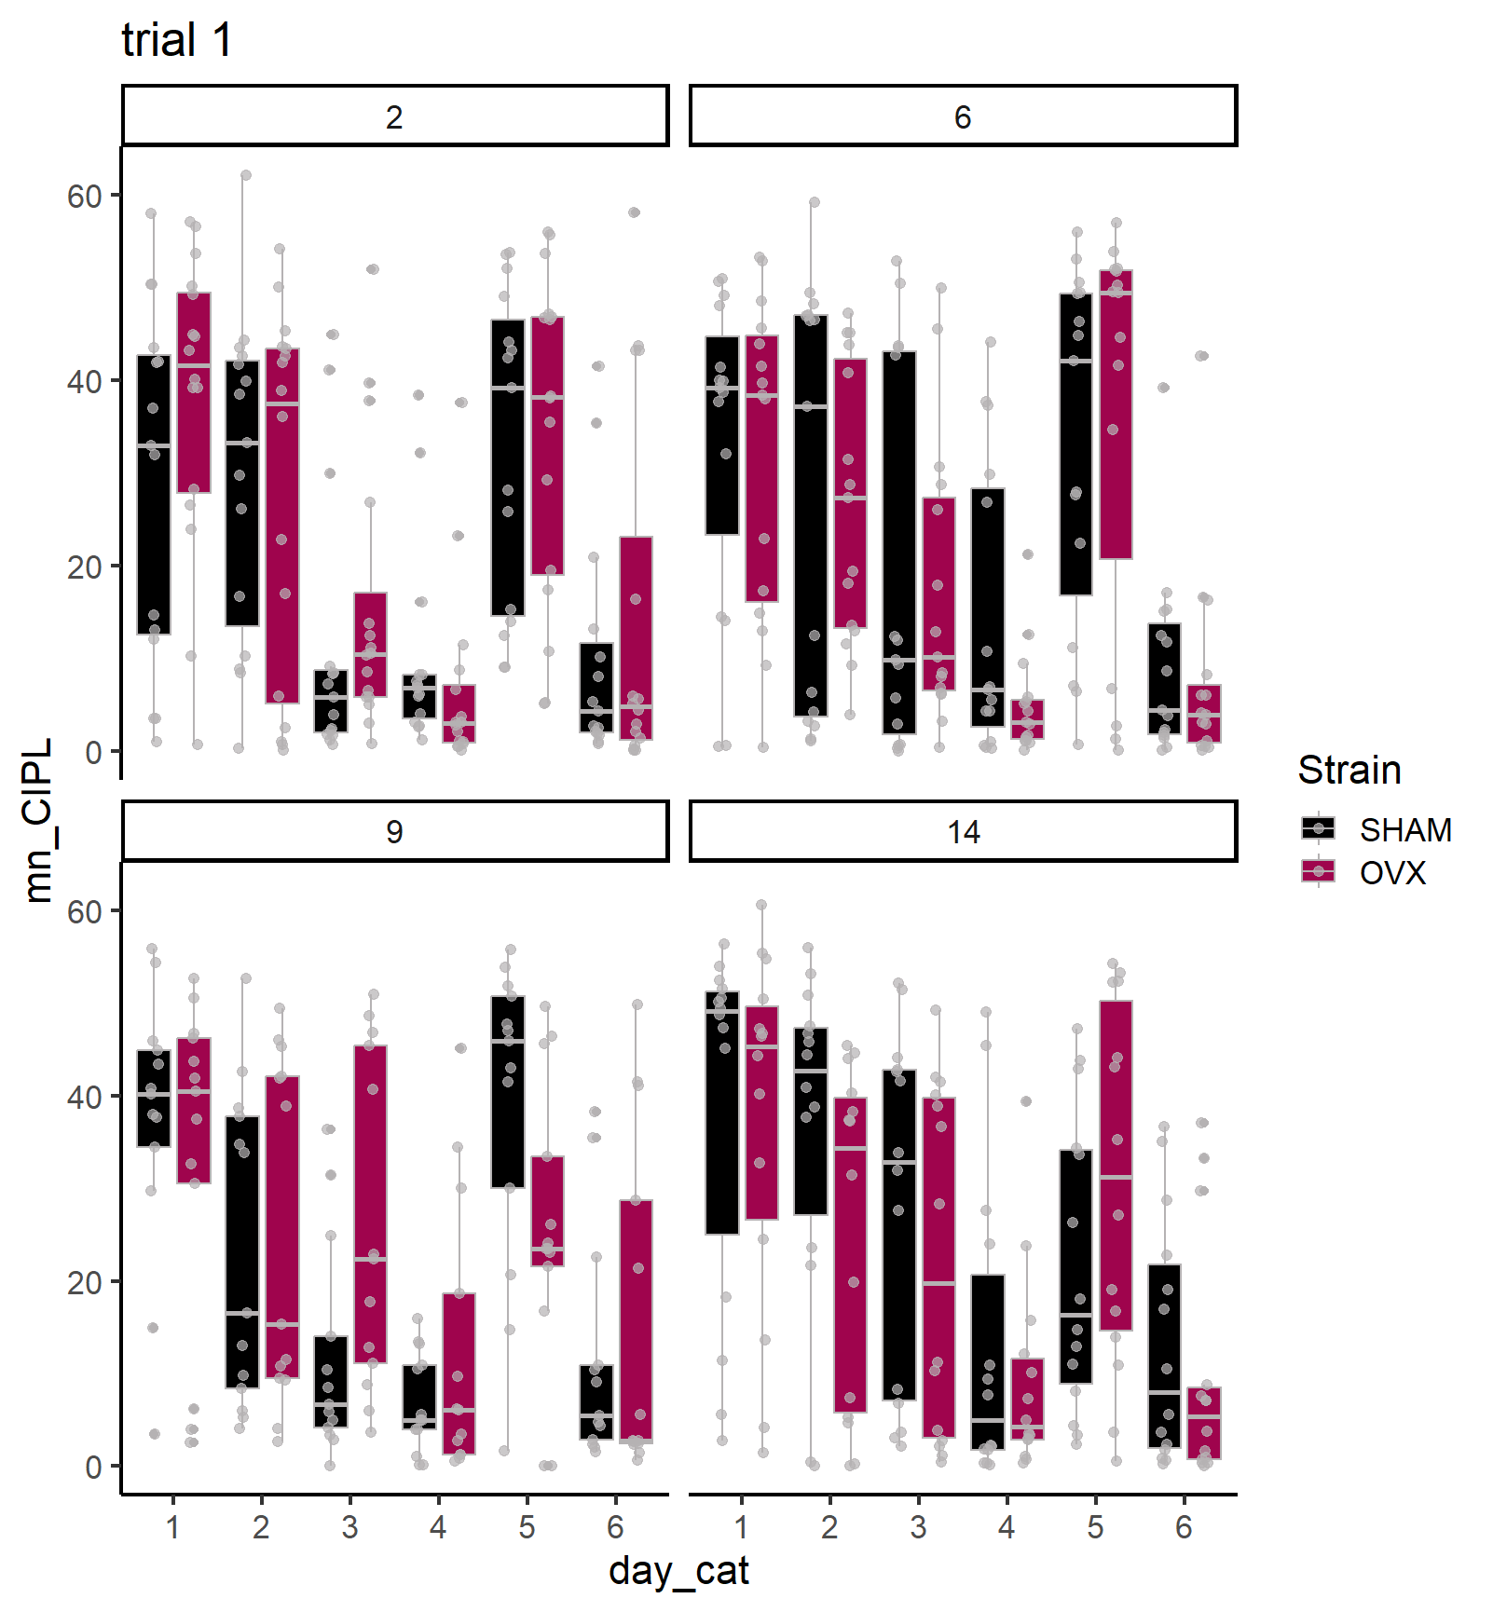
Trial 1 reflects the carryover from the previous day.

Slide 8
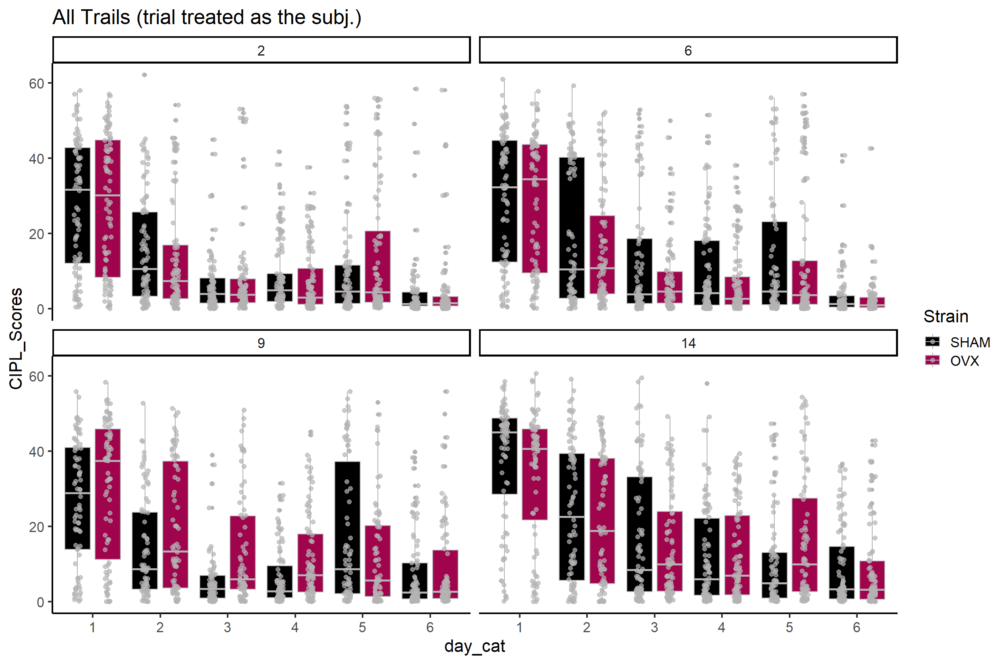

Slide 9
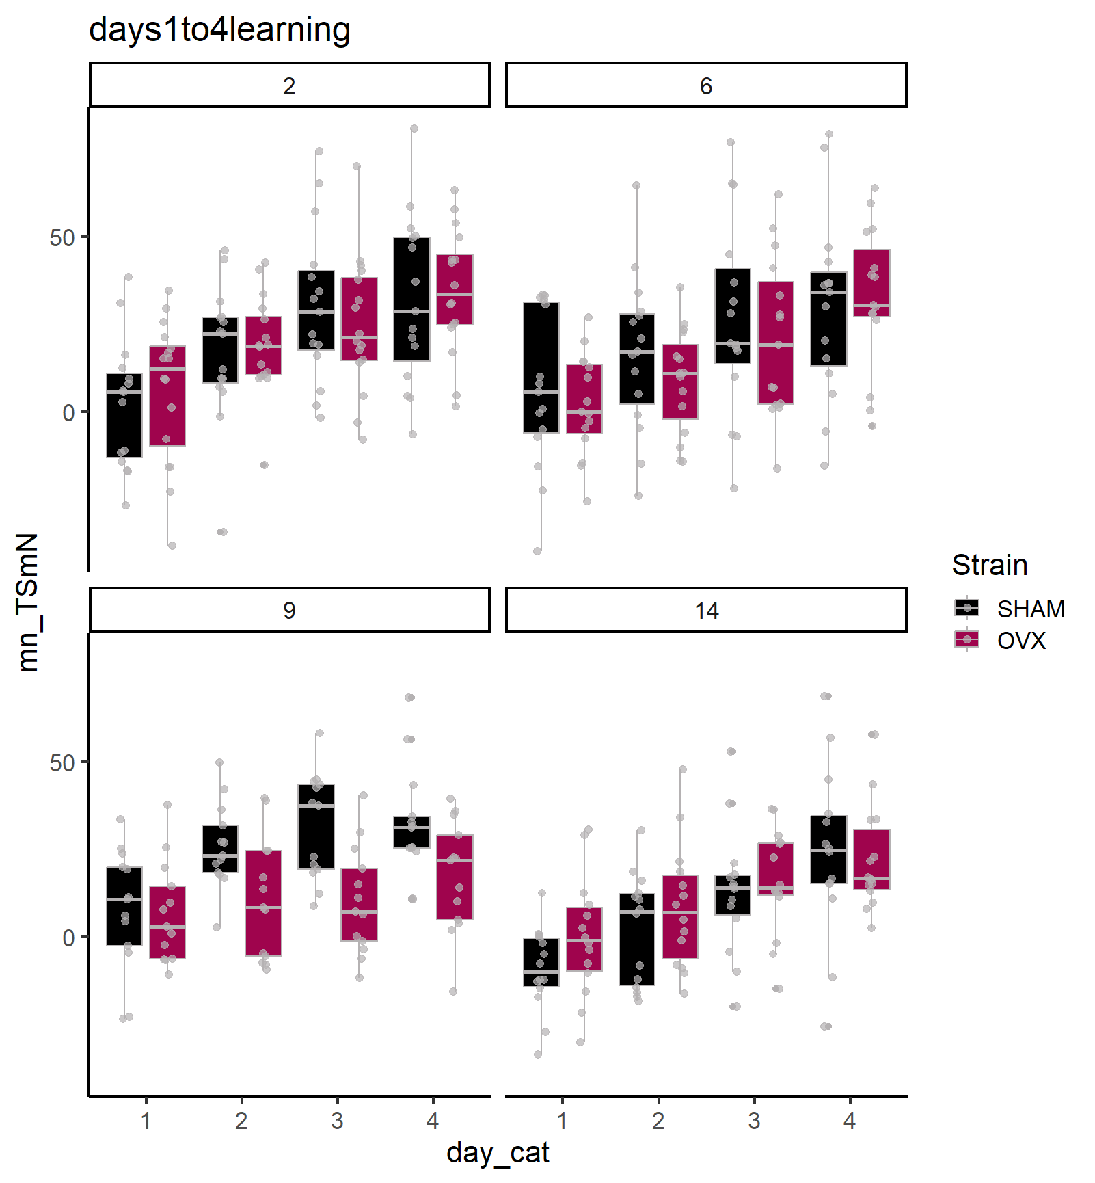
Time in the SOUTH quadrant (goal for days 1-4) minus time in the NORTH (goal days > 4).
Nice effect on day 9 across training.

Slide 10
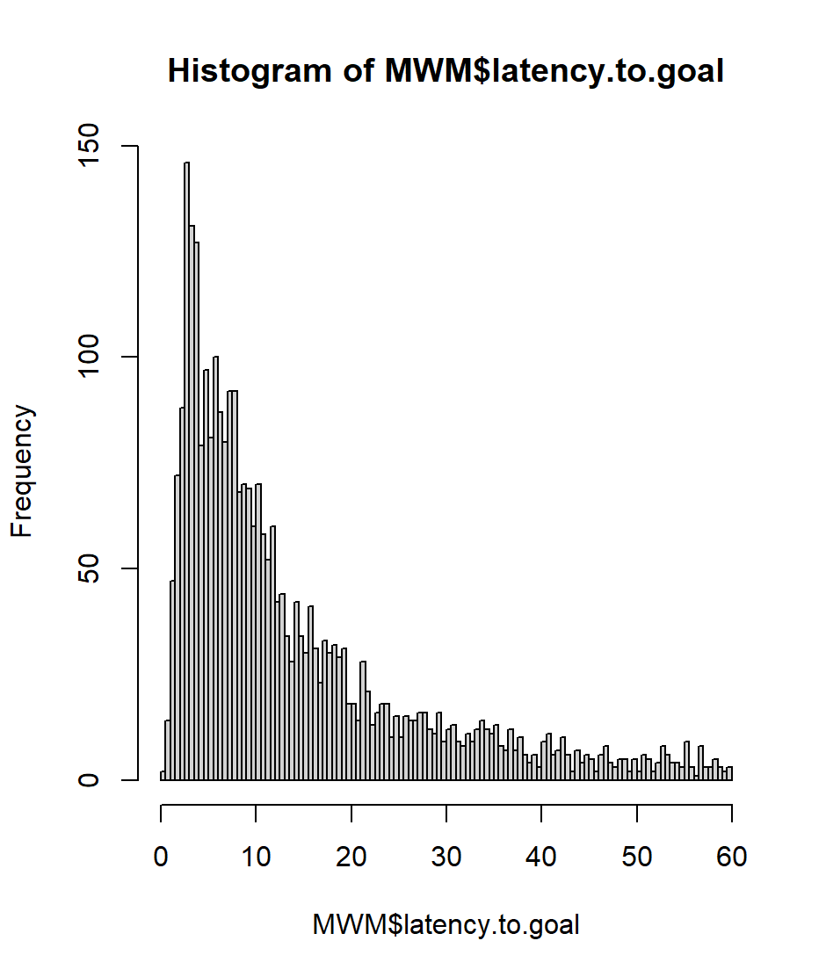
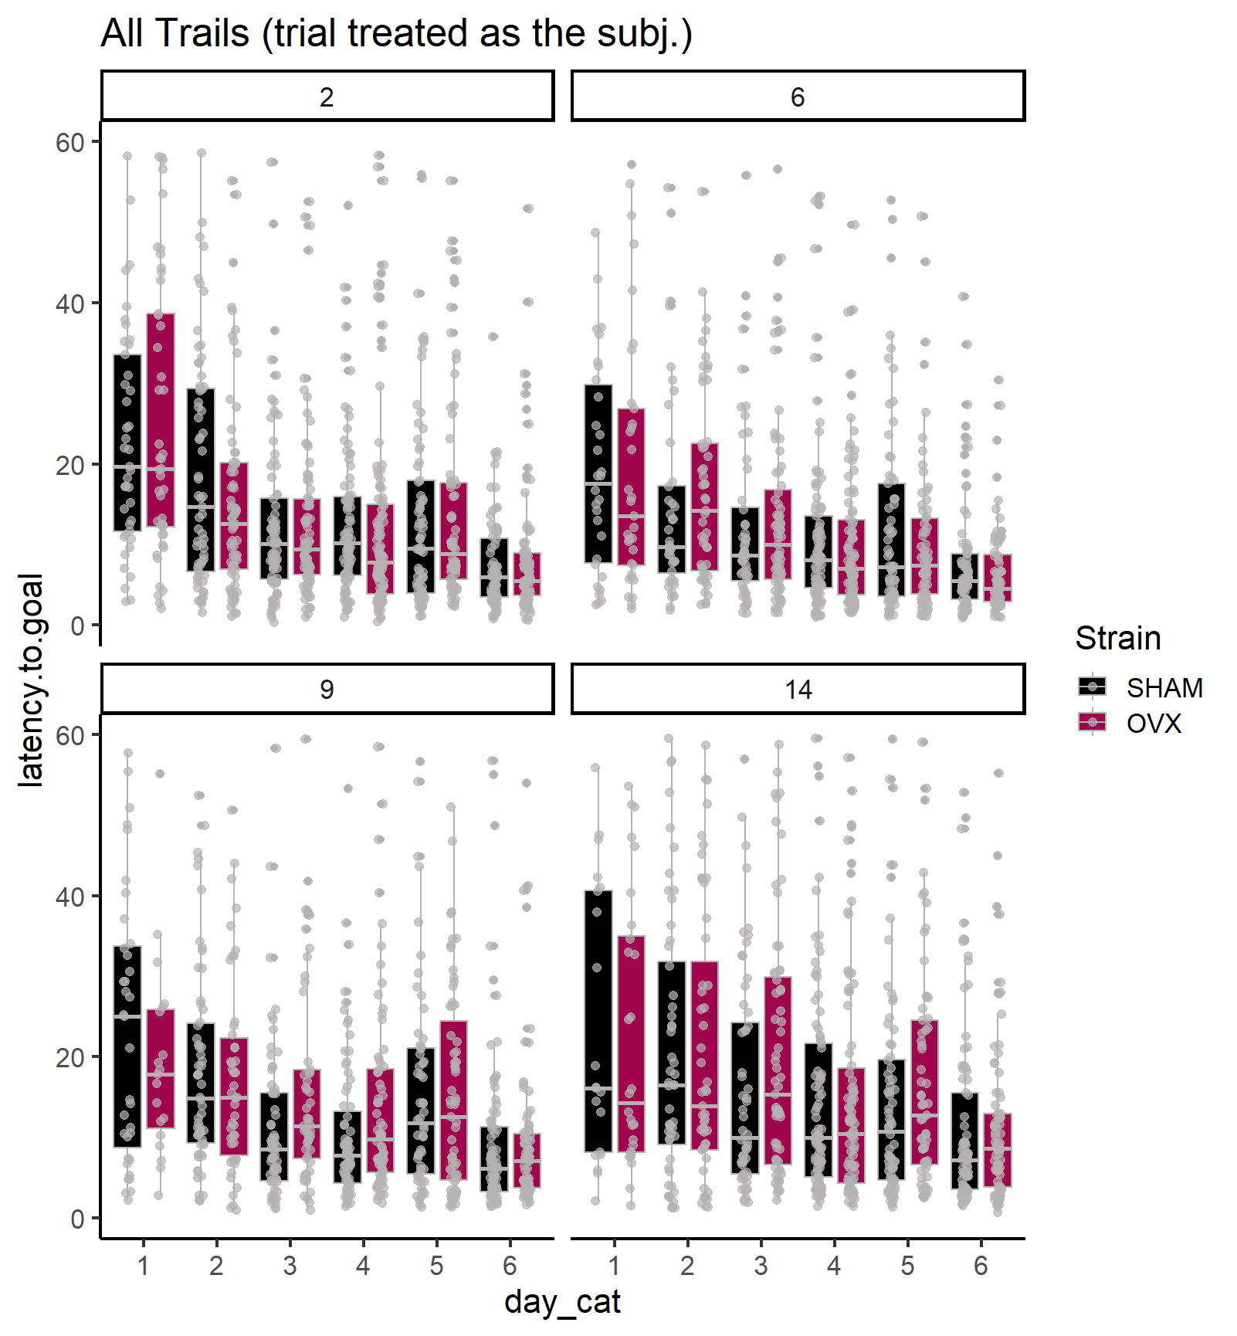

Slide 11
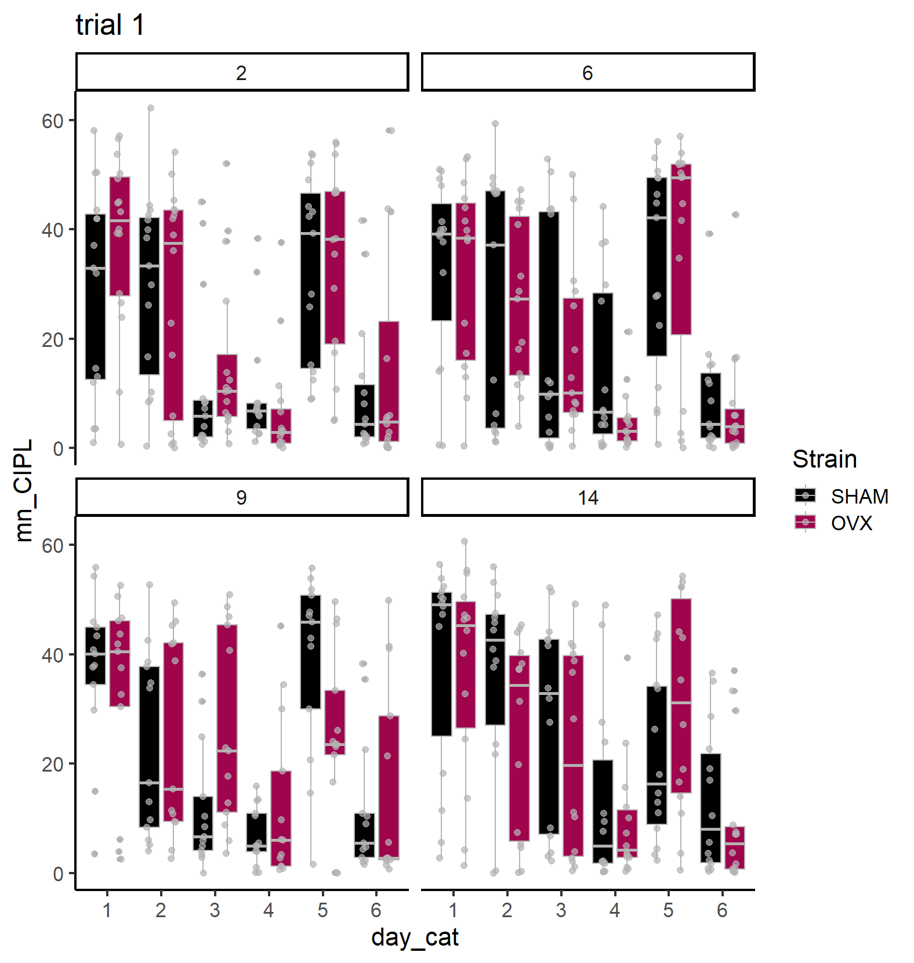

Slide 12
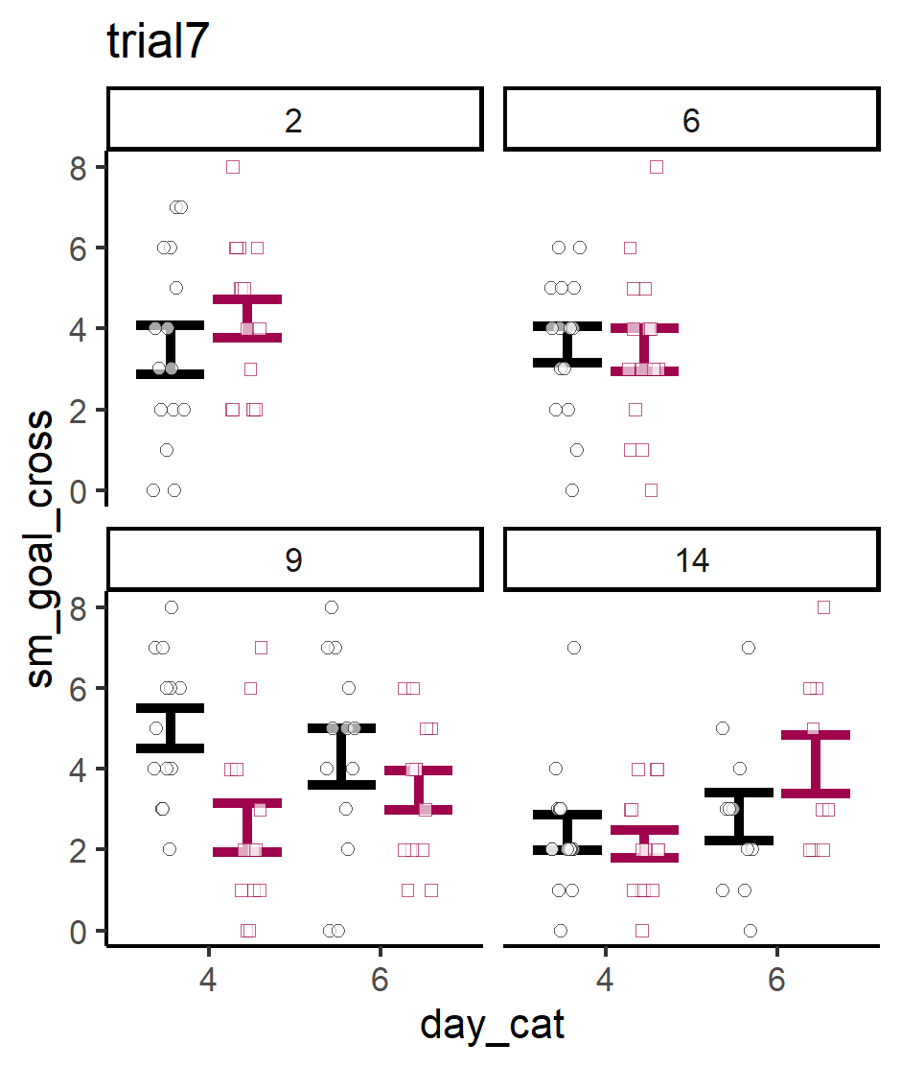

Slide 13
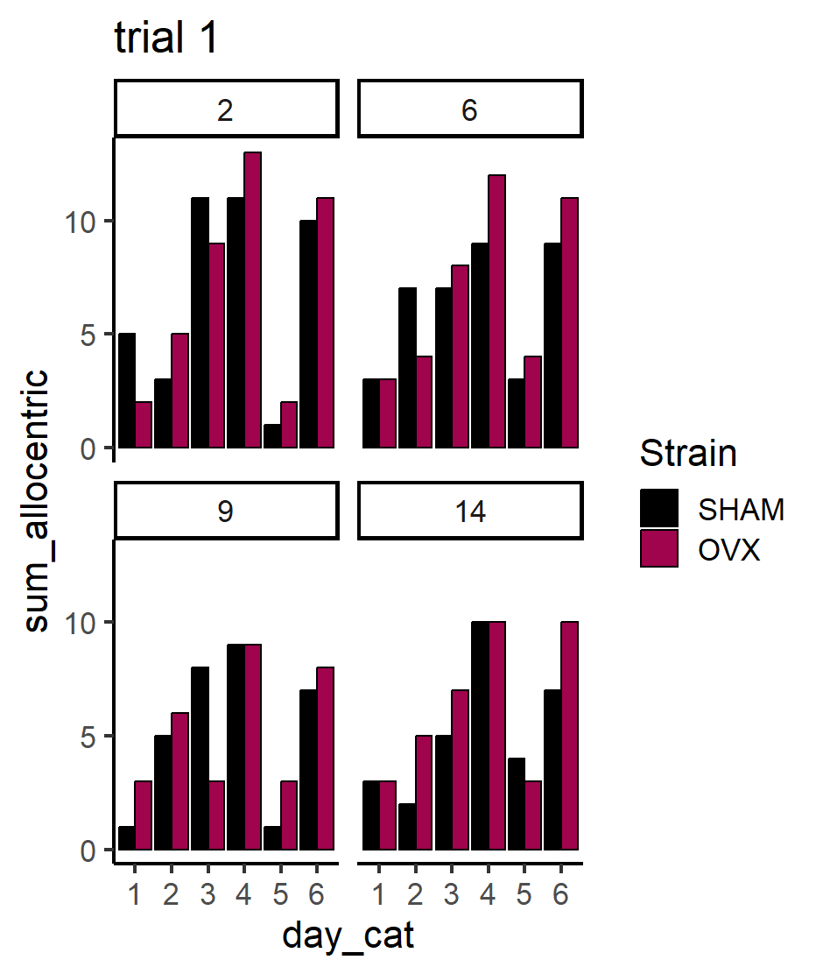

Slide 14
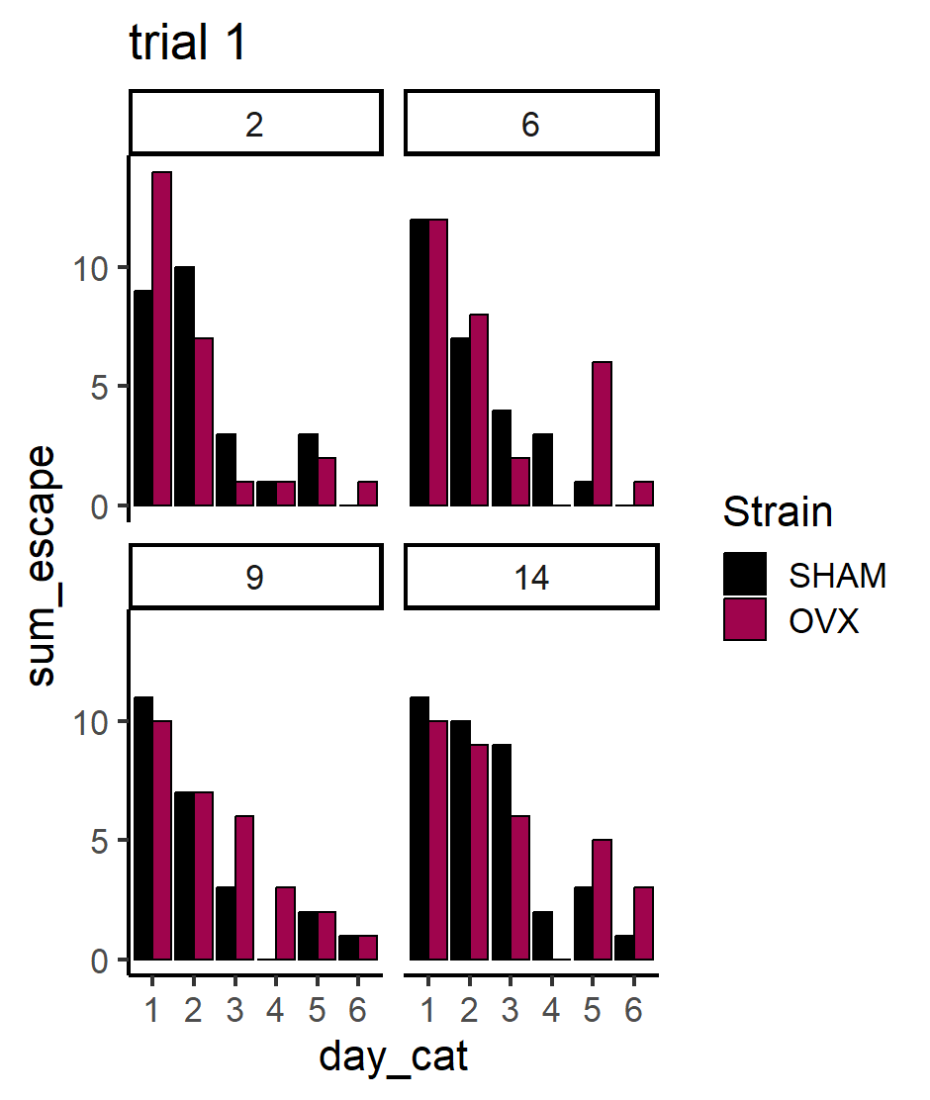

Slide 15
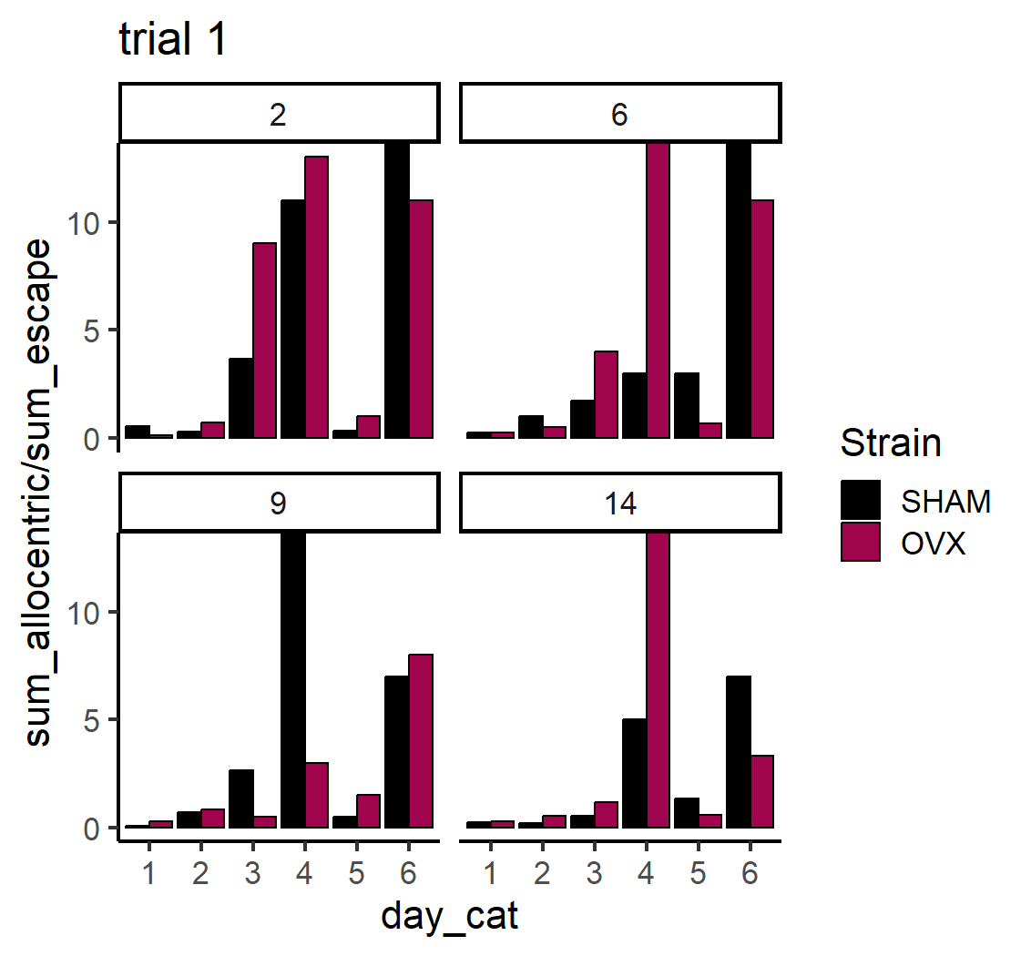

Slide 16
Probe trials on day 4 and 6 are strange: only really scanning or random path. Is there something wrong with how strategy is computed during probe trials?
Thus – there is virtually NO allocentric on any probe trial on days 4,6

Slide 17
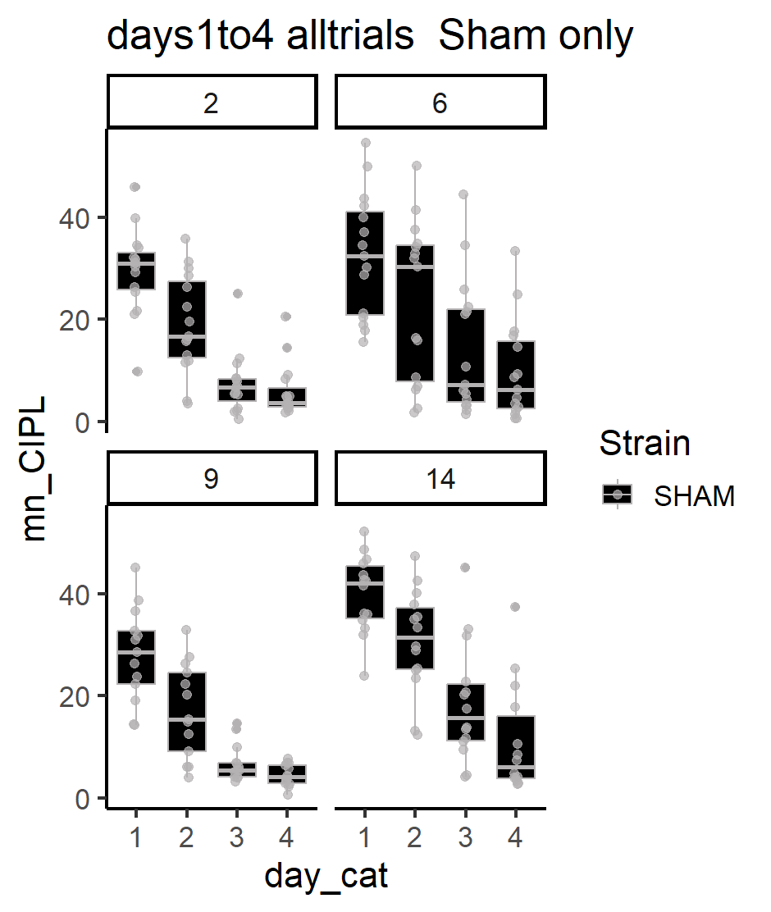
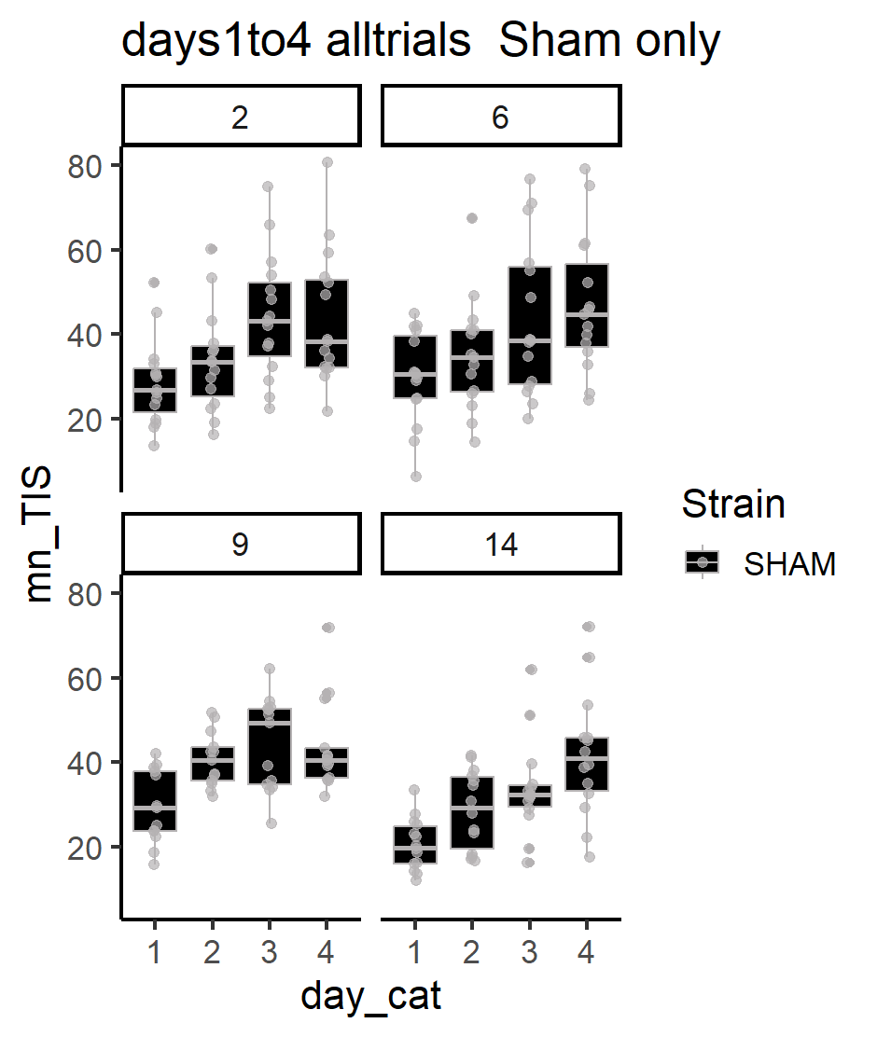
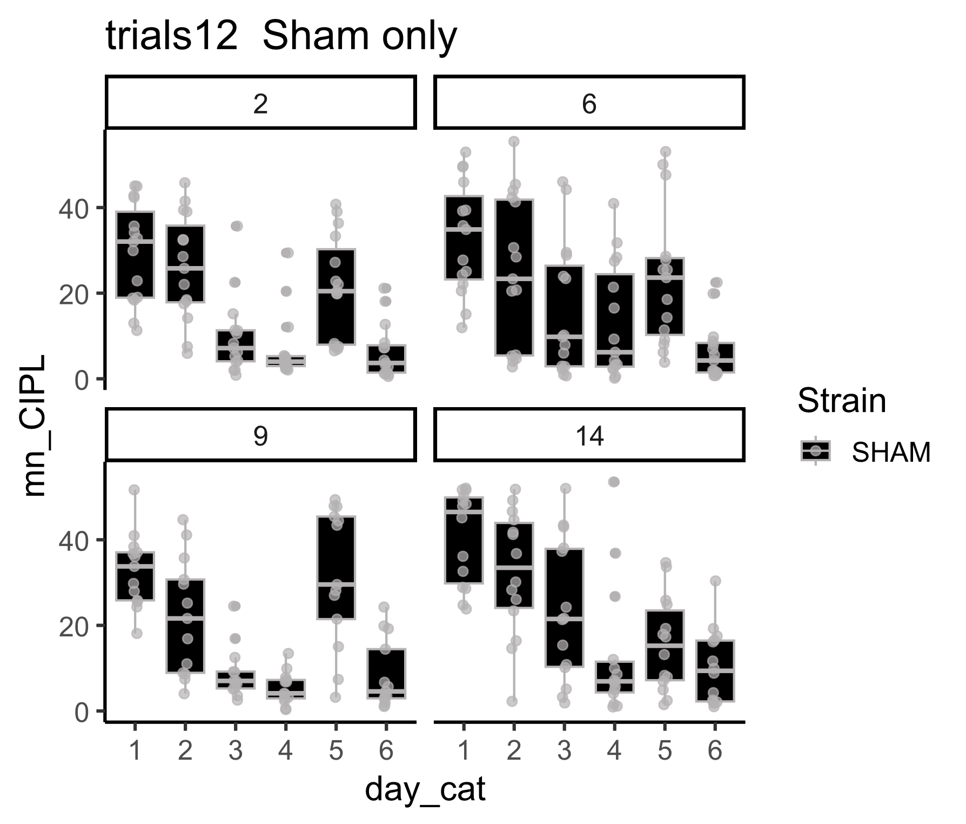

Slide 18
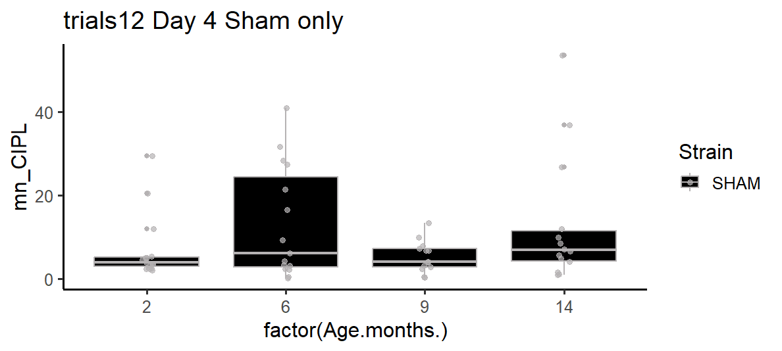

Slide 19
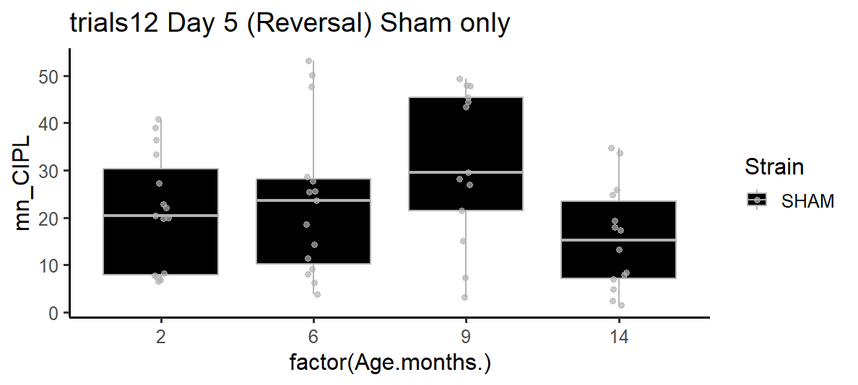
Reversal performance for Sham only.

Slide 20
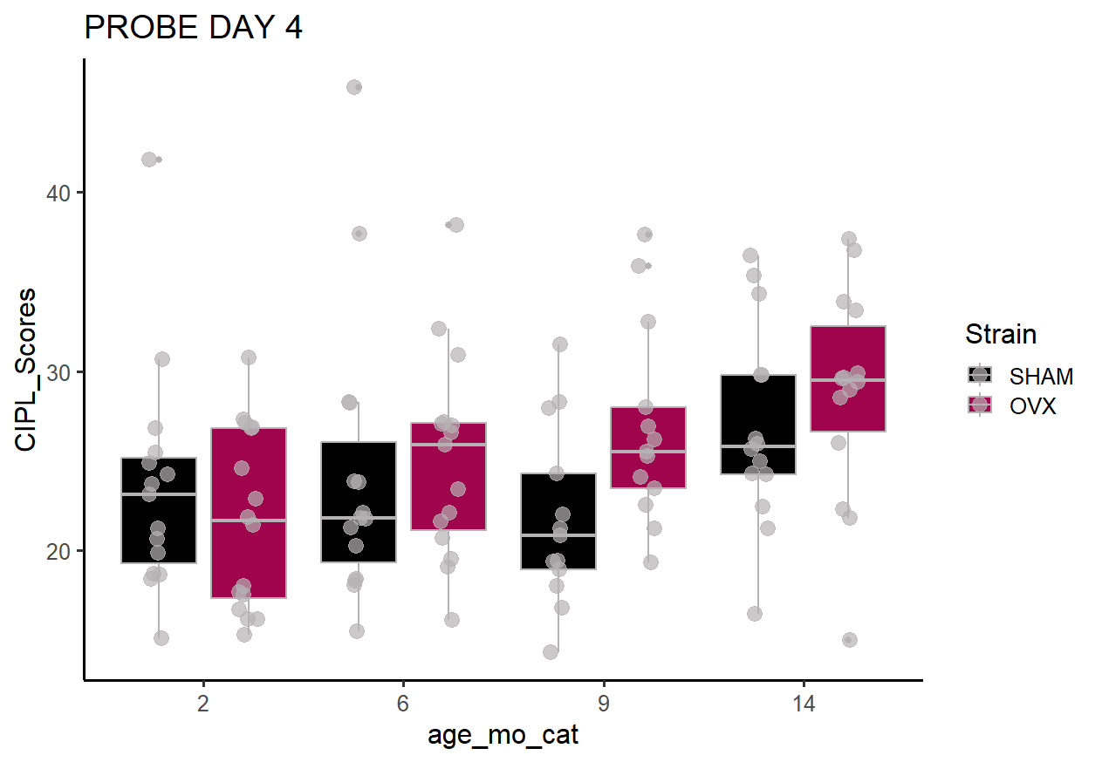

Slide 21
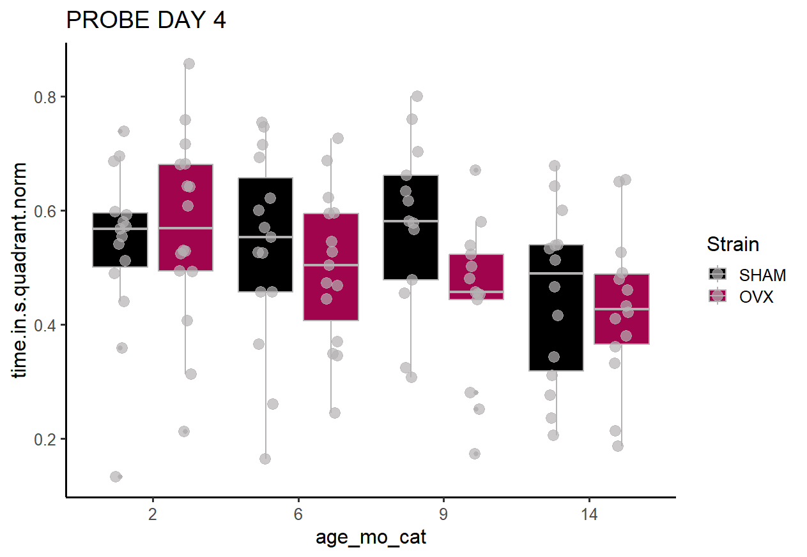

Slide 22
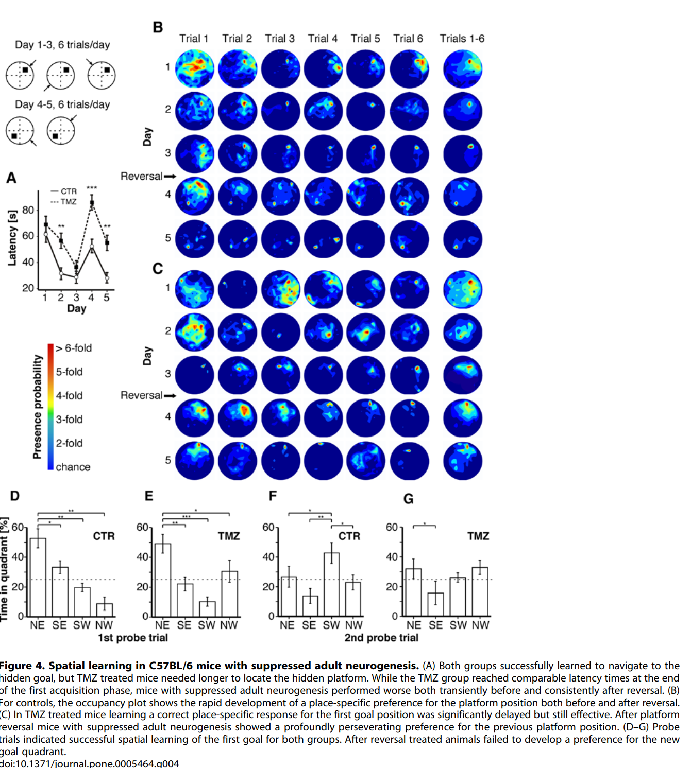
Garthe 2009

Slide 23
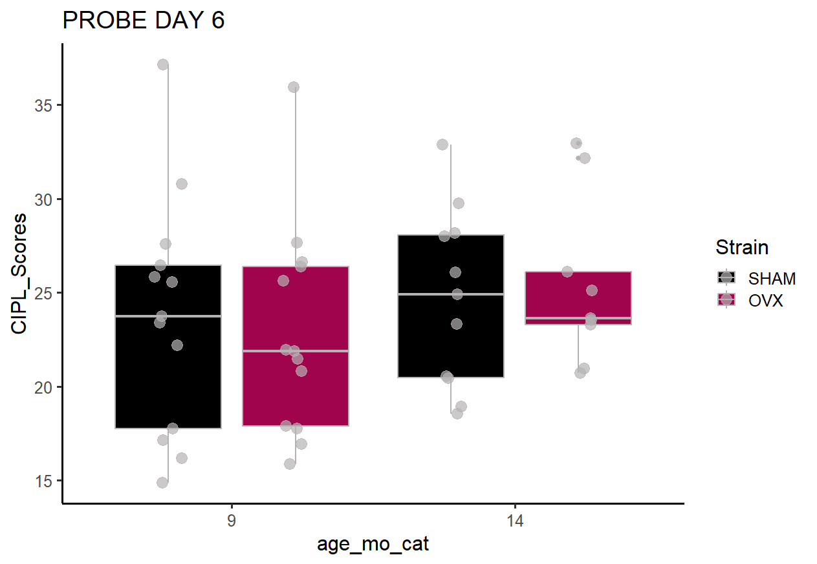

Slide 24
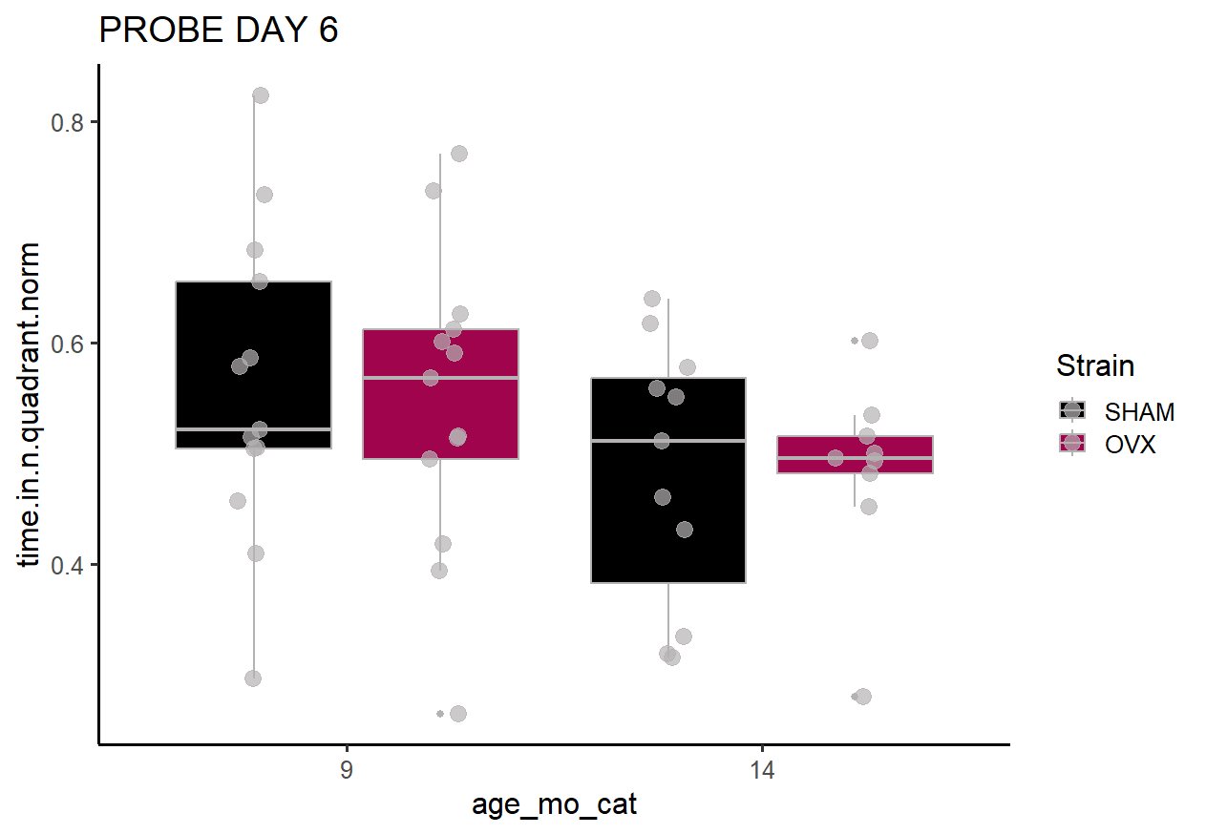

Slide 25
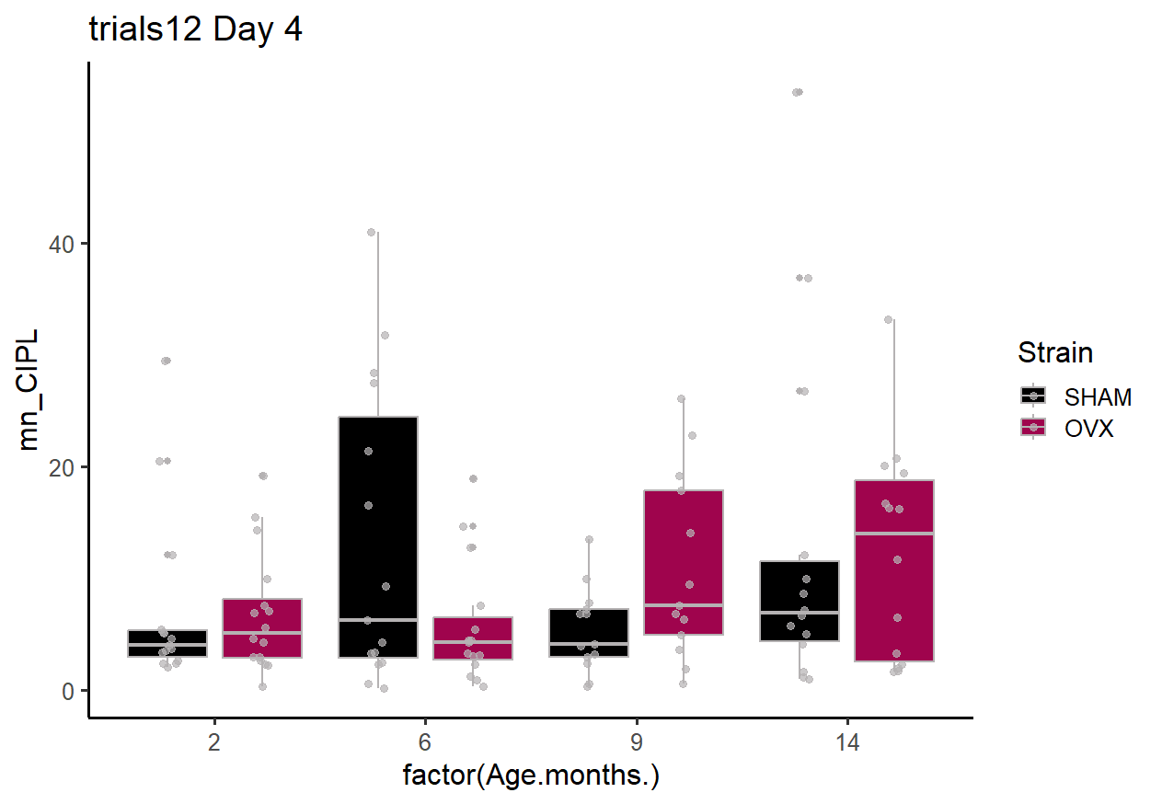

Slide 26
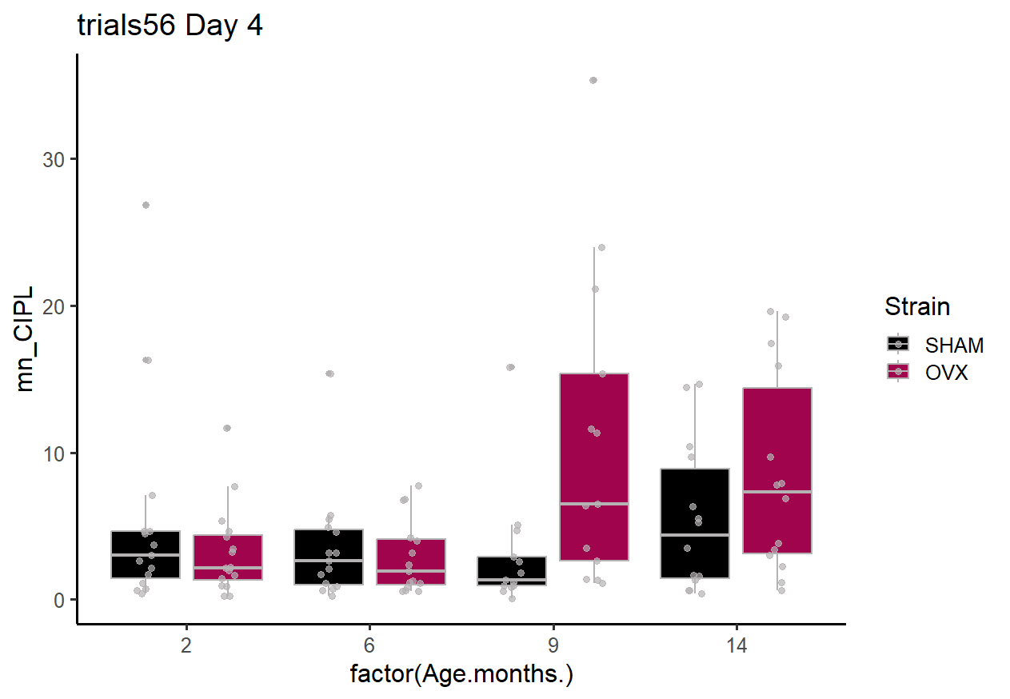

Slide 27
